Slide 1
2.5 MRI Super Resolution
EEL 6935: Deep Learning in Medical Image Analysis
Fall 2025
Deivanai Thiyagarajan

Slide 2
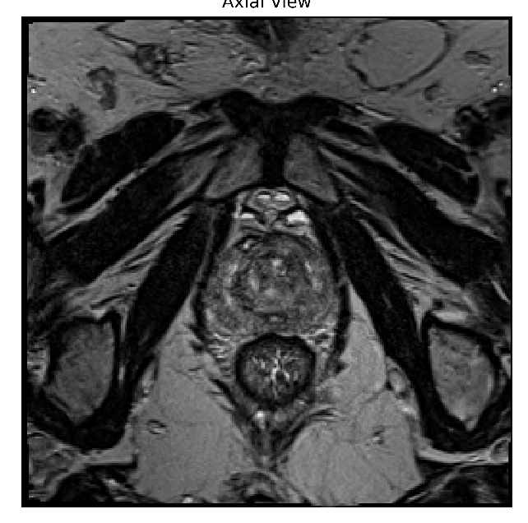

Problem Motivation & Dataset
Multi –Image Super Resolution for MRI
Clinical Problem: MRI has anisotropic resolution → Fine in-plane (0.66mm), but coarse Z spacing (1.5-6mm)
Missing anatomical details between slices → affects diagnosis
Goal: Predict the intermediate slices → improve Z-resolution
Dataset: T2 weighted MRI prostate biopsy dataset
Image Properties:
In-plane spacing: 0.664 X 0.664 mm
Out-of-Plane Z spacing: 1.5mm
Pixel type: 16-bit unsigned integer
Consistent acquisition geometry (identity direction matrix)

Slide 3
Preprocessing Steps & Evaluation Metrics
Extracted Triplets: (slice i, slice i+2) → predict slice i+1
Also extracted 6mm gap triplets using (i, i+4) → predict i+2
Normalized intensities and aligned slices using z-score normalization
Ensured Consistent dimension across all subjects
Data Augmentation: Random Horizontal Flips and Rotation of (-5 to +5 degrees) → trained models both with and without augmentation
Evaluation Metrics: SSIM and PSNR

Slide 4
Models Compared
Model | Description | Loss Type
UNet (Baseline) | Simple Encoder-Decoder predicting the middle slice (double conv blocks + transpose upsampling) Inputs are two slices stacked as channels (shape: (B, 2, H, W)) and output is a single predicted middle slice (shape: (B, 1, H, W)). | MSE Loss, MSE + Perceptual + SSIM loss
DeepCNN (Residual CNN) | Deep residual style network using residual blocks (convolution + batchnorm + ReLU) and progressive feature expansions. Input format is the same as UNet (`(B,2,H,W)`) | MSE Loss
UNet-GAN | UNet-like generator used inside a GAN training framework. The generator structure mirrors UNet but is optimized together with a discriminator (not included here) to encourage realistic textures and sharper reconstructions. | MSE + Perceptual + Adversarial
FastDDPM | UNet-style generator conditioned on diffusion timestep embeddings. Faster sampling with smart scheduling → both cosine and linear beta scheduling, uniform and non-uniform noise scheduler Input = pre + post + noisy middle slice, enabling the model to reconstruct anatomically consistent middle slices even with only 10 reverse steps. | MSE Loss
Progressive UNet | Multi-stage coarse-to-fine architecture → (UNet1: (i,i+4)→i+2), (UNet2: (i,i+2_pred)→ i+1), (UNet3: (i+2_pred, i+4)→ (i+3)) Each stage uses the output of the previous stage as input, enabling robust long-range interpolation while preserving anatomical consistency. Designed specifically for 3–6 mm gaps, reduces effective interpolation distance for each UNet and improves global coherence across predicted slices. | Progressive UNet uses auxiliary gradients at intermediate layers (like MobileNet)
All Models are trained with standard learning rate of 1e-4 and batch size = 4. All UNet blocks consist of 4 Encoder, 4 Decoder and 1 Bottleneck layer

Slide 5
Quantitative Results
Model | Epochs | Val Loss | SSIM Score | PSNR Score
Deep CNN | 20 | 0.0956 | 0.7098 | 23,61
UNet with MSE Loss | 20 | 0.0767 | 0.7642 | 25.49
UNet with Combined Loss | 20 | 0.0770 | 0.7714 | 25.78
Progressive UNet | 27 | 0.1876 | 0.7520 | 25.93
UNet Generator with Discriminator | 20 | 0.0976 | 0.7711 | 25.68
Fast DDPM (light 2-layer, linear beta) | 20 | - | 0.628 | 22.97
Fast DDPM (heavy residual layers, cosine beta) | 40 | 0.2251 | 0.6371 | 22.85

Slide 6
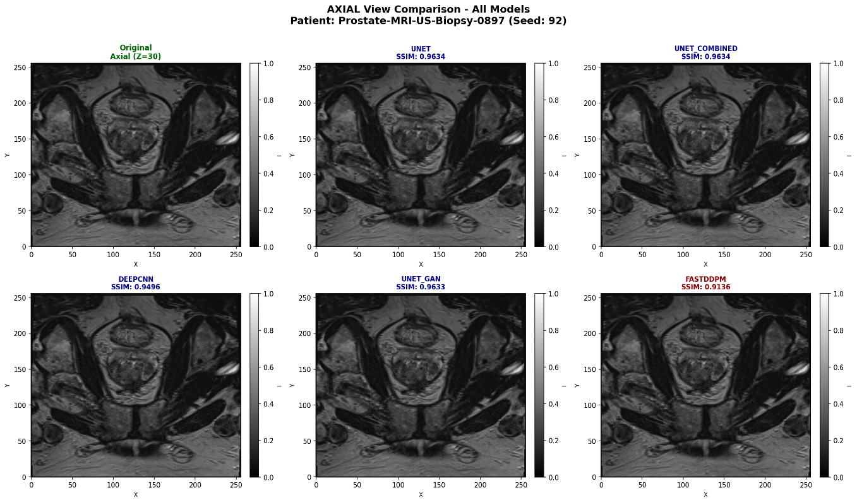
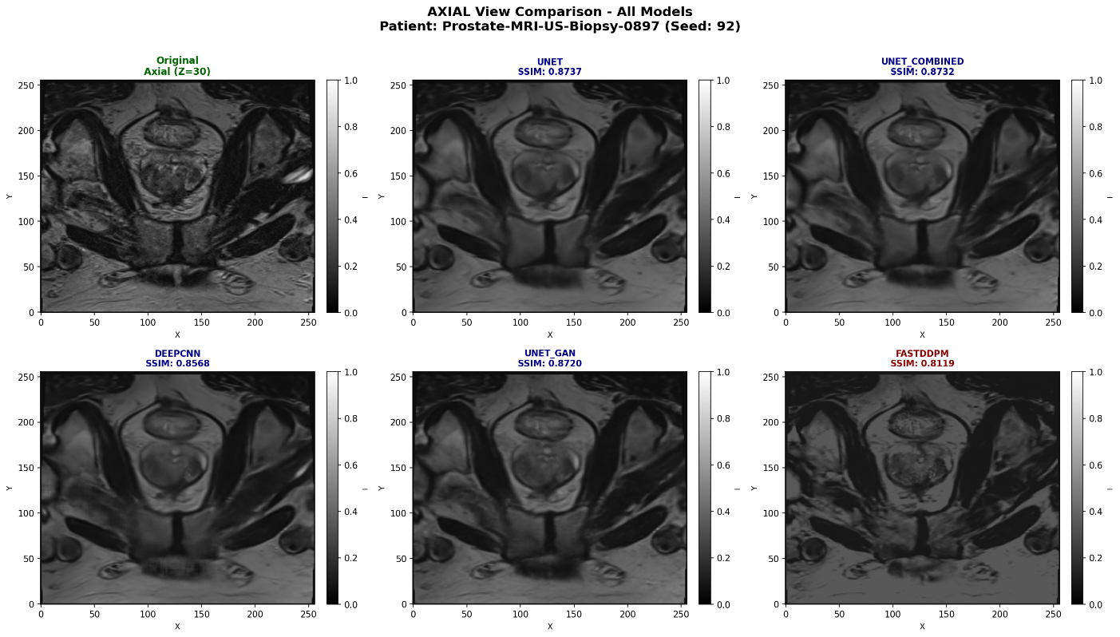
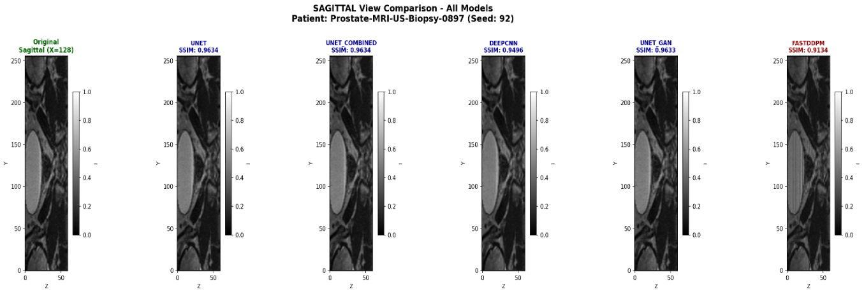

Qualitative Results – All Models(3,6mm gap addressing)
3mm InterSliceSpacing
6mm InterSliceSpacing

Slide 7
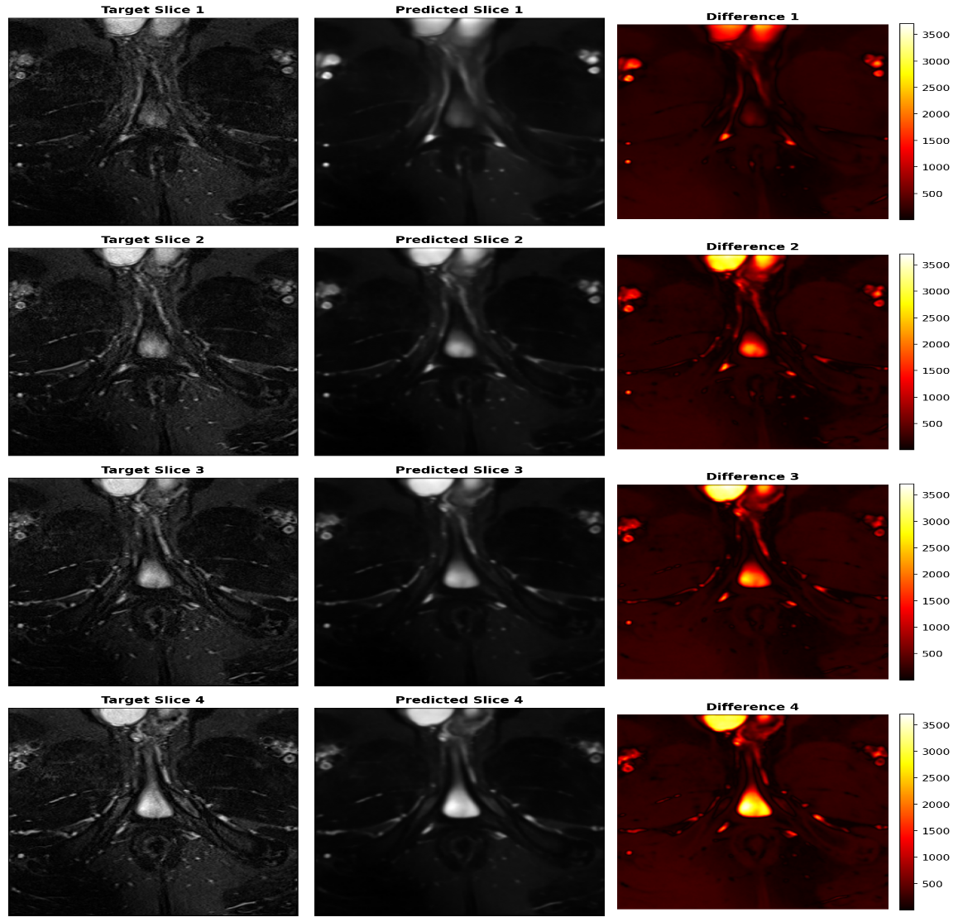
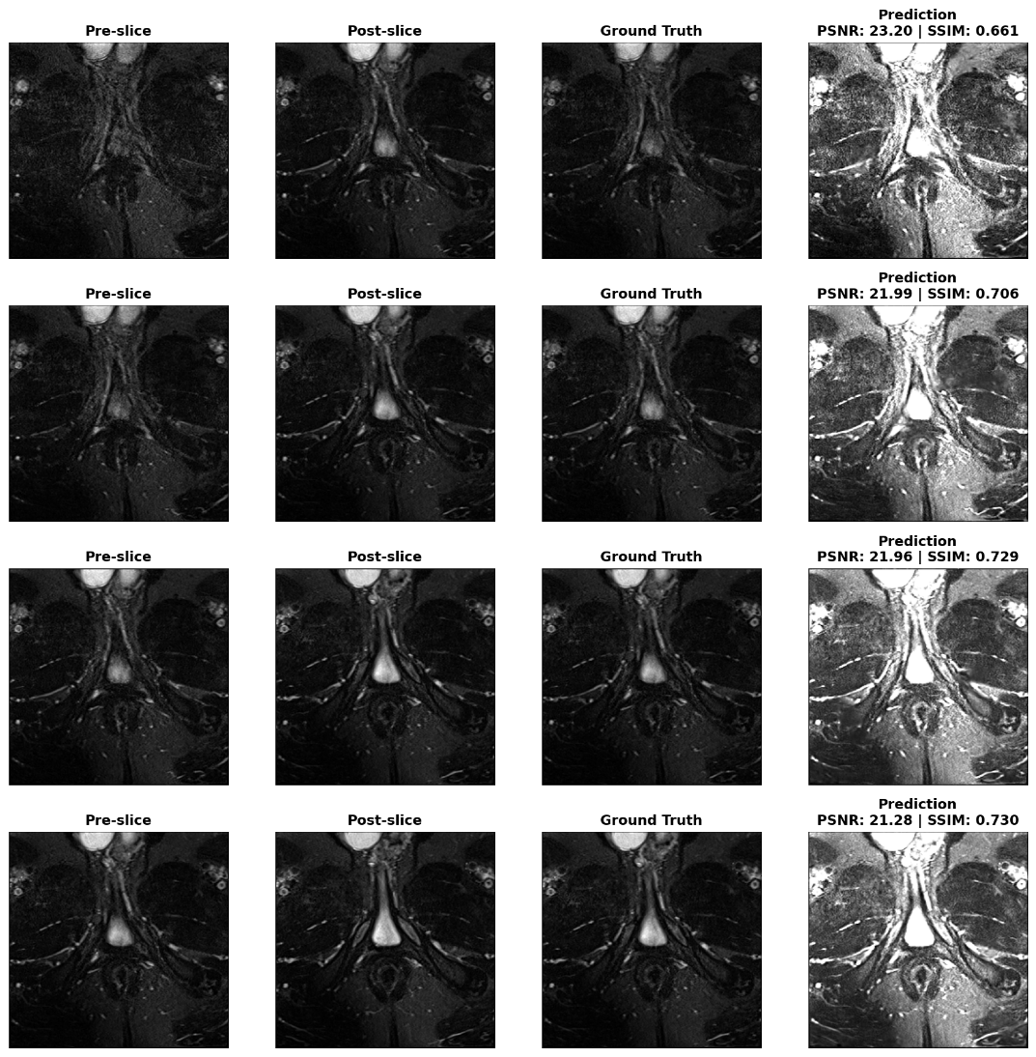
Qualitative Results – Fast DDPM
Non Uniform Scheduler – Cosine Scheduling, Heavy Residual Layers
Non Uniform Scheduler – Linear Beta Scheduling, Simple 2 Residual Layers

Slide 8
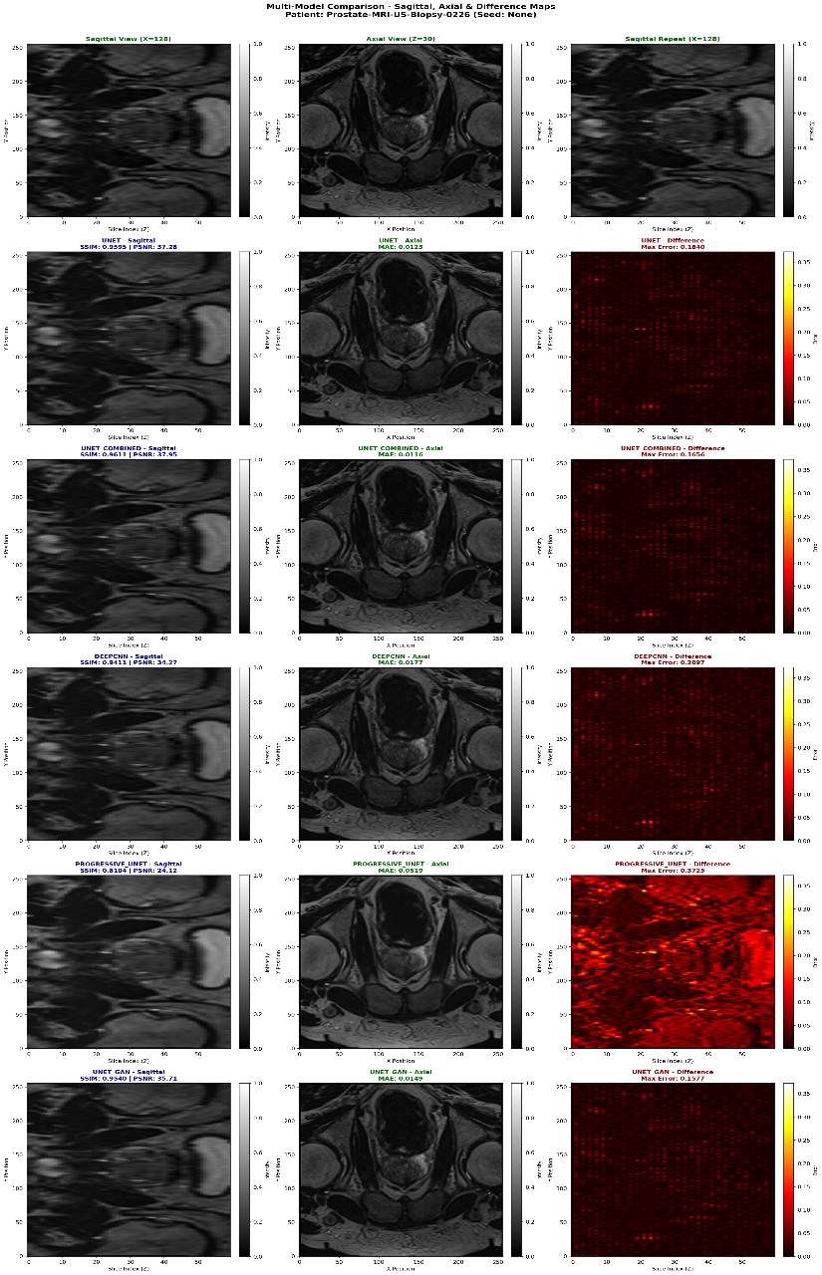
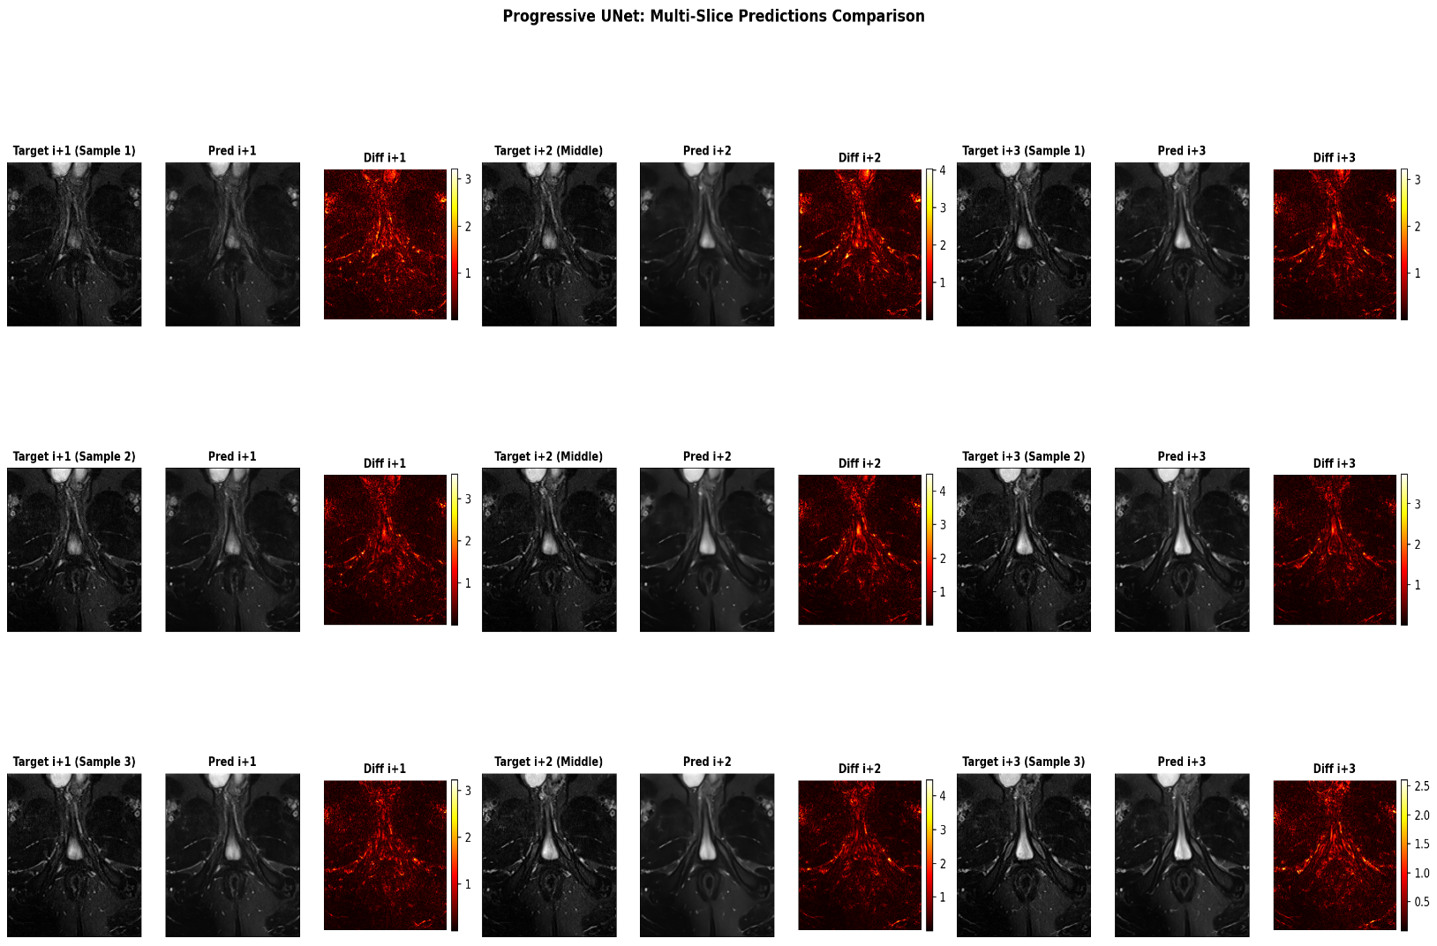
Qualitative Results – Progressive UNET

Slide 9
Key Findings and Conclusion
Key Findings
Comparative Performance
UNet-based models (MSE, Combined Loss, GAN) significantly outperform DDPM approaches
Best performer: UNet with Combined Loss (SSIM: 0.7714, PSNR: 25.78 dB)
Fast-DDPM underperforms: SSIM 0.6371, PSNR 22.85 dB (13% SSIM gap)
Architecture Insights
Direct regression (UNet) more suitable for medical image interpolation than generative models
Adversarial training (GAN) provides marginal gains (0.7711 vs 0.7642 SSIM)
Combined loss functions work better than single MSE loss alone
Computational Trade-offs
Fast-DDPM: Faster inference (10 steps) but lower quality
UNet variants: Slower but provide superior clinical utility

Slide 10
References
GitHub Link: https://github.com/DeivanaiThiyagarajan/Multi-Image-Super-Resolution
Fast DDPM - https://arxiv.org/pdf/2405.14802
miSRGAN - https://www.sciencedirect.com/science/article/pii/S1361841521000037

